Slide 1


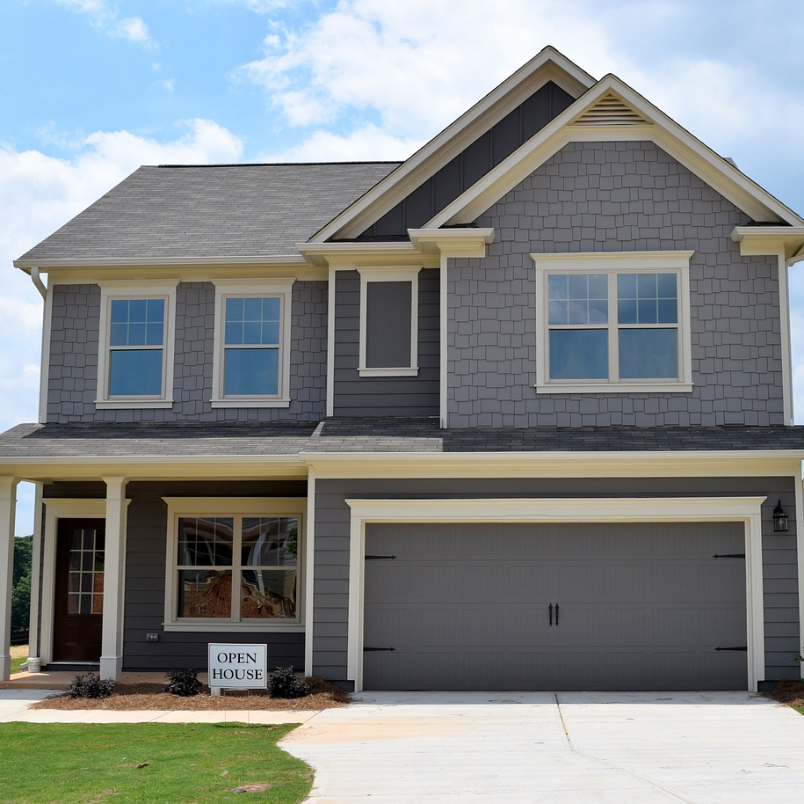
HOUSE RENT PREDICTION
Name: G. Bhavya Sri
Roll No:22P31A4214
College: Aditya college ofengineering and technology

Slide 2
ABSTRACT:
This study focuses on predicting house rents using R programming, employing various machine learning algorithms. Data preprocessing and feature engineering techniques are utilized to enhance model accuracy. Multiple models, including linear regression, decision trees, and random forests, are evaluated for performance. Cross-validation and hyperparameter tuning are applied to ensure robust predictions. The results demonstrate the efficacy of advanced analytical techniques in forecasting rental prices.

Slide 3

INTRODUCTION:
In this study, we aim to predict house rents using R programming by analyzing a comprehensive dataset. The dataset includes various attributes such as location, size, amenities, and age of the properties, which are crucial factors influencing rental prices. We utilize data preprocessing and feature engineering techniques to clean and transform the data for accurate modeling. By applying machine learning algorithms like linear regression, decision trees, and random forests, we seek to identify patterns and relationships within the data. Cross-validation and hyperparameter tuning are performed to enhance model performance and ensure robust predictions. The goal is to determine the most effective approach for rent prediction and provide valuable insights into the rental market. This analysis aids in making informed decisions for both renters and property managers.

Slide 4
TECHNOLOGIES:
To predict house rents using R programming, we employ a range of advanced technologies and methodologies. Key technologies include:
R Programming Language: For data manipulation, statistical analysis, and model implementation.
Tidy verse Package: For data cleaning and preprocessing, utilizing tools
Caret Package: For building and tuning machine learning models.
Linear Regression: To model the relationship between rental prices and property features.

Slide 5
Decision Trees and Random Forests: For capturing non-linear relationships and interactions between features.
Cross-Validation: To evaluate model performance and ensure generalizability.
Hyperparameter Tuning: To optimize model parameters and improve accuracy.
Visualization Libraries (ggplot2): For exploratory data analysis and result presentation.

Slide 6

PROBLEM STATEMENT:
The problem statement for this project is to develop an accurate and reliable model to predict house rental prices using R programming. Given a dataset containing various features such as location, size, number of rooms, and amenities, the goal is to understand how these factors influence rental prices. By leveraging machine learning algorithms and data analysis techniques, we aim to build a predictive model that can provide accurate rental price estimates for different properties. This model will help renters, landlords, and real estate professionals make informed decisions. Key challenges include dealing with missing data, feature selection, and model validation to ensure robustness and generalizability.

Slide 7
PROJECT SPECIFICATION:
The project aims to predict house rental prices using R programming. It involves importing a comprehensive dataset containing property attributes. Initial steps include data exploration through summary statistics and visualizations like scatterplots and density plots to understand variable relationships and distributions. Feature selection focuses on identifying significant predictors such as location, size, and amenities. Data preprocessing addresses null values and ensures data integrity. Modeling utilizes techniques like linear regression and decision trees for prediction accuracy. Model evaluation includes metrics such as RMSE and R-squared to assess performance. Results are presented with visualizations and insights into rental market trends.

Slide 8
Simple Explanation of Initial Steps for House Rent Prediction Using R:
1.Import Dataset: Load the dataset into the R programming environment from a file, such as a CSV.
2. Data Exploration: Understand the data by looking at summary statistics and visualizing relationships between different variables and the rent.
3. Feature Selection: Identify and choose the most important features (variables) that influence the rental price, such as location, size, and amenities.
4. Checking Null Values: Find and handle any missing data in the dataset to ensure accuracy, either by filling in the gaps or removing incomplete entries.
5. Figure Out House Age: Calculate the each house by subtracting the year it was built from the current year, and use this as a feature in the model.

Slide 9
Plot Correlation Matrix: Examine how each variable in the dataset relates to others, specifically how features like square footage and location correlate with rental prices. This helps identify which variables might be most influential in predicting rent.
Plot Scatterplots: Visualize the relationship between variables, such as square footage and rental price. Scatterplots show how two variables move together and help identify any patterns or trends that could influence the rent prediction.
Plot Density Plot to Check Normality: Check the distribution of rental prices to see if they follow a normal (bell-shaped) distribution. This is important because many statistical techniques assume normality, ensuring that predictions and conclusions drawn from the data are reliable.
Plot Univariate Linear Regression between square feet living and price: Explore how changes in square footage affect rental prices by fitting a straight line to the data points in the scatterplot.

Slide 10
RESULTS:
The output of the house rent prediction project in R includes:
Predicted rental prices based on selected features like location, size, and amenities.
Visualizations such as scatterplots and regression lines illustrating relationships between variables.
Evaluation metrics such as RMSE and R-squared to assess model accuracy.
Insights into influential factors affecting rental prices, derived from feature importance analysis.

Slide 11
Recommendations for renters and property managers based on predicted trends and market dynamics.
Summary of data preprocessing steps, ensuring data quality and model reliability.
Documentation of model performance and validation techniques applied.
Potential for future enhancements in modeling techniques or data sources to improve predictions.

Slide 12



